Slide 1
Metrics and Validation
Sean Malone, University of Maryland
Justin Boblitt, CCMC GSFC

Slide 2
Plan
Goals of Project
Implementation of the Project Goals
Problems During Implementation
Solutions to Problems
Conclusion and Lessons Learned

Slide 3
Goals of the Project
Demonstrate the Capabilities of Agile Programming
Calculate an Initial Set of Skill Scores
Use User Set Boundaries
Create an Interactive Chart to Display Data

Slide 4
Agile Programming
A project management style formatted from SCRUM
Characterized by sprints, user stories, and sprint meetings
Sprint meetings with users

Slide 5
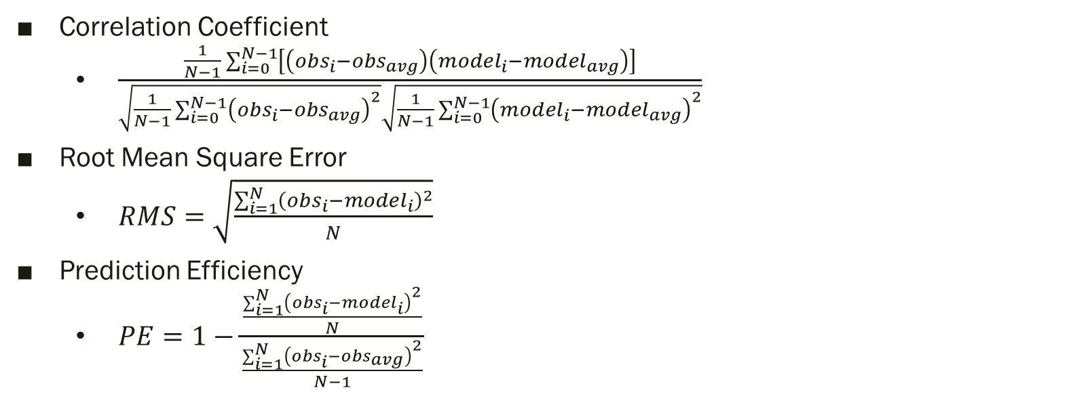
Initial Skill Scores
Correlation Coefficient
$\frac{\frac{1}{N−1}\sum_{i=0}^{N−1}{\left[\left({obs}_{i}−{obs}_{avg}\right)\left({model}_{i}−{model}_{avg}\right)\right]}}{\sqrt{\frac{1}{N−1}\sum_{i=0}^{N−1}{{\left({obs}_{i}−{obs}_{avg}\right)}^{2}}}\sqrt{\frac{1}{N−1}\sum_{i=0}^{N−1}{{\left({model}_{i}−{model}_{avg}\right)}^{2}}}}$
Root Mean Square Error
$RMS=\sqrt{\frac{\sum_{i=1}^{N}{{\left({obs}_{i}−{model}_{i}\right)}^{2}}}{N}}$
Prediction Efficiency
$PE=1−\frac{\frac{\sum_{i=1}^{N}{{\left({obs}_{i}−{model}_{i}\right)}^{2}}}{N}}{\frac{\sum_{i=1}^{N}{{\left({obs}_{i}−{obs}_{avg}\right)}^{2}}}{N−1}}$

Slide 6

Problems/Solutions
Linear Interpolation of Data
$\frac{\left(y_{2}−y_{1}\right)\left(x_{des}−x_{1}\right)}{\left(x_{2}−x_{1}\right)}+y_{1}$
Coordinate Transformation
Graphing Library

Slide 7
Conclusions and Lessons Learned
Agile is a viable software development method
Achieves Program Goal: Facilitates Model Growth

